Slide 1
Selected Topics in Computer Science
Chapter 3
Data warehouse

Slide 2
Out lines
What is data warehouse?
Characteristics of Data Warehouse
Data warehouse vs Operational DBMS
OLTP (On-Line Transaction Processing) vs OLAP (On-Line Analytical processing)
Design of a Data Warehouse
Typical OLAP Operations
Data Warehouse Design Process
Three Data Warehouse Architectures

Slide 3
Introduction to data warehouse
a data warehouse is a subject oriented, integrated, time-variant, and non-volatile collection of data.
Subject-oriented:e.g. customers, patients, students, products
Integrated: consistent naming conventions, formats, encoding structures; from multiple data sources
Time-variant: can study trends and changes
Non-updatable: read-only, periodically refreshed
This data helps analysts to take informed decisions in an organization. An operational database undergoes frequent changes on a daily basis on account of the transactions that take place.
Suppose a business executive wants to analyze previous feedback on any data such as a product, a supplier, or any consumer data, then the executive will have no data available to analyze because the previous data has been updated due to transactions.

Slide 4
Why a Data Warehouse is Separated from Operational Databases
A data warehouses is kept separate from operational databases due to the following reasons:
An operational database is constructed for well-known tasks and workloads such as searching particular records, indexing, etc.
In contrast, data warehouse queries are often complex and they present a general form of data.
Operational databases support concurrent processing of multiple transactions.
Concurrency control and recovery mechanisms are required for operational databases to ensure robustness and consistency of the database.
An operational database query allows to read and modify operations, while an OLAP query needs only read only access of stored data.
An operational database maintains current data. On the other hand, a data warehouse maintains historical data.

Slide 5
Data Warehouse Features
The key features of a data warehouse are discussed below:
Subject Oriented - A data warehouse is subject oriented because it provides information around a subject rather than the organization's ongoing operations.
These subjects can be product, customers, suppliers, sales, revenue, etc. A data warehouse does not focus on the ongoing operations, rather it focuses on modeling and analysis of data for decision making.
Integrated - A data warehouse is constructed by integrating data from heterogeneous sources such as relational databases, flat files, etc. This integration enhances the effective analysis of data.
Time Variant - The data collected in a data warehouse is identified with a particular time period. The data in a data warehouse provides information from the historical point of view.

Slide 6
Data Warehouse Features
Non-volatile - Non-volatile means the previous data is not erased when new data is added to it. A data warehouse is kept separate from the operational database and therefore frequent changes in operational database is not reflected in the data warehouse.
Note: A data warehouse does not require transaction processing, recovery, and concurrency controls, because it is physically stored and separate from the operational database.

Slide 7
Types of Data Warehouse Applications
Information processing, analytical processing, and data mining are the three types of data
warehouse applications that are discussed below:
Information Processing - A data warehouse allows to process the data stored in it.
The data can be processed by means of querying, basic statistical analysis, reporting using crosstabs, tables, charts, or graphs.
Analytical Processing - A data warehouse supports analytical processing of the information stored in it.
The data can be analyzed by means of basic OLAP operations, including slice and-dice, drill down, drill up, and pivoting.
Data Mining - Data mining supports knowledge discovery by finding hidden patterns and associations, constructing analytical models, performing classification and prediction.
These mining results can be presented using the visualization tools.

Slide 8
Data Warehousing
Data warehousing is the process of constructing and using a data warehouse.
A data warehouse is constructed by integrating data from multiple heterogeneous sources that support analytical reporting, structured and/or ad hoc queries, and decision making.
Data warehousing involves data cleaning, data integration, and data consolidations.
Integrating Heterogeneous Databases
To integrate heterogeneous databases, we have two approaches:
Query-driven Approach
Update-driven Approach
Query-Driven Approach: This is the traditional approach to integrate heterogeneous databases. This approach was used to build wrappers and integrators on top of multiple heterogeneous databases. These integrators are also known as mediators.

Slide 9
Data Warehousing
Process of Query-Driven Approach: When a query is issued to a client side, a metadata dictionary translates the query into an appropriate form for individual heterogeneous sites involved.
Now these queries are mapped and sent to the local query processor. The results from heterogeneous sites are integrated into a global answer set.
Disadvantages
Query-driven approach needs complex integration and filtering processes.
This approach is very inefficient.
It is very expensive for frequent queries.
This approach is also very expensive for queries that require aggregations.

Slide 10
Data Warehousing
Update-Driven Approach: This is an alternative to the traditional approach. Today's data warehouse systems follow update driven approach rather than the traditional approach discussed earlier.
In update-driven approach, the information from multiple heterogeneous sources are integrated in advance and are stored in a warehouse. This information is available for direct querying and analysis.
Advantages
This approach has the following advantages:
This approach provide high performance.
The data is copied, processed, integrated, annotated, summarized and restructured in semantic data store in advance.
Query processing does not require an interface to process data at local sources.

Slide 11
Functions of Data Warehouse Tools and Utilities
The following are the functions of data warehouse tools and utilities:
Data Extraction - Involves gathering data from multiple heterogeneous sources.
Data Cleaning - Involves finding and correcting the errors in data.
Data Transformation - Involves converting the data from legacy format to warehouse format.
Data Loading - Involves sorting, summarizing, consolidating, checking integrity, and building indices and partitions.
Refreshing - Involves updating from data sources to warehouse.
Note: Data cleaning and data transformation are important steps in improving the quality of data and data mining results.

Slide 12
DATA WAREHOUSING - TEERMINOLOGIES
In this chapter, we will discuss some of the most commonly used terms in data warehousing.
1. Metadata
Metadata is simply defined as data about data. The data that are used to represent other data is known as metadata.
For example, the index of a book serves as a metadata for the contents in the book.
In other words, we can say that metadata is the summarized data that leads us to the detailed data.
In terms of data warehouse, we can define metadata as following:
  Metadata is a road-map to data warehouse.
  Metadata in data warehouse defines the warehouse objects.
  Metadata acts as a directory. This directory helps the decision support system to locate the contents of a data warehouse.

Slide 13
DATA WAREHOUSING - TEERMINOLOGIES
2. Data Cube
A data cube helps us represent data in multiple dimensions. It is defined by dimensions and facts. The dimensions are the entities with respect to which an enterprise preserves the records.
Illustration of Data Cube
Suppose a company wants to keep track of sales records with the help of sales data warehouse with respect to time, item, branch, and location.
These dimensions allow to keep track of monthly sales and at which branch the items were sold. There is a table associated with each dimension.
This table is known as dimension table. For example, "item" dimension table may have attributes such as item_name, item_type, and item_brand. The following table represents the 2-D view of Sales Data for a company with respect to time, item, and location dimensions.

Slide 14
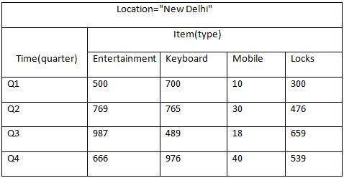
DATA WAREHOUSING - TEERMINOLOGIES
.

Slide 15
DATA WAREHOUSING - TEERMINOLOGIES
But here in this 2-D table, we have records with respect to time and item only. The sales for New
Delhi are shown with respect to time, and item dimensions according to type of items sold. If we
want to view the sales data with one more dimension, say, the location dimension, then the 3-D
view would be useful. The 3-D view of the sales data with respect to time, item, and location is
shown in the table below:

Slide 16
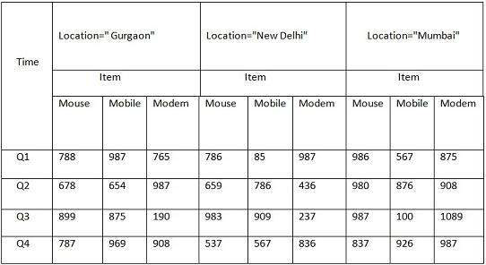
DATA WAREHOUSING - TEERMINOLOGIES
.

Slide 17
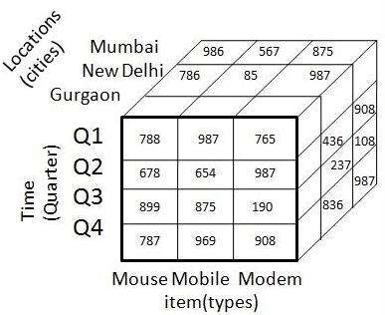
DATA WAREHOUSING - TEERMINOLOGIES
The above 3-D table can be represented as 3-D data cube as shown in the following figure:

Slide 18
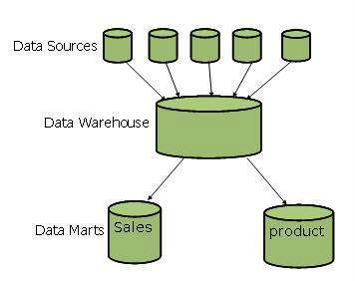
DATA WAREHOUSING - TEERMINOLOGIES
3. Data Mart
Data marts contain a subset of organization-wide data that is valuable to specific groups of people in an organization.
In other words, a data mart contains only those data that is specific to a particular group. For example, the marketing data mart may contain only data related to items, customers, and sales. Data marts are confined to subjects.
The following figure shows a graphical representation of data marts.

Slide 19
DATA WAREHOUSING - SYSTEM PROCESSES
We have a fixed number of operations to be applied on the operational databases and we have well-defined techniques such as use normalized data, keep table small, etc.
These techniques are suitable for delivering a solution. But in case of decision-support systems, we do not know what query and operation needs to be executed in future.
Therefore techniques applied on operational databases are not suitable for data warehouses. In this chapter, we will discuss how to build data warehousing solutions on top open-system technologies like Unix and relational databases.

Slide 20
DATA WAREHOUSING - SYSTEM PROCESSES
Process Flow in Data Warehouse
There are four major processes that contribute to a data warehouse:
Extract and load the data.
Cleaning and transforming the data.
Backup and archive the data.
Managing queries and directing them to the appropriate data sources.

Slide 21
DATA WAREHOUSING - SYSTEM PROCESSES
Extract and Load Process
Data extraction takes data from the source systems. Data load takes the extracted data and loads it into the data warehouse.
Note: Before loading the data into the data warehouse, the information extracted from the external sources must be reconstructed.
Clean and Transform Process
Once the data is extracted and loaded into the temporary data store, it is time to perform Cleaning and Transforming.
Here is the list of steps involved in Cleaning and Transforming:
  Clean and transform the loaded data into a structure
  Partition the data
  Aggregation

Slide 22
DATA WAREHOUSING - SYSTEM PROCESSES
Clean and Transform the Loaded Data into a Structure
Cleaning and transforming the loaded data helps speed up the queries. It can be done by making the data consistent:
  within itself.
  with other data within the same data source.
  with the data in other source systems.
  with the existing data present in the warehouse.
Transforming involves converting the source data into a structure. Structuring the data increases the query performance and decreases the operational cost.
The data contained in a data warehouse must be transformed to support performance requirements and control the ongoing operational costs.

Slide 23
DATA WAREHOUSING - SYSTEM PROCESSES
Partition the Data
It will optimize the hardware performance and simplify the management of data warehouse. Here we partition each fact table into multiple separate partitions.
Aggregation
Aggregation is required to speed up common queries. Aggregation relies on the fact that most common queries will analyze a subset or an aggregation of the detailed data.

Slide 24
DATA WAREHOUSING - SYSTEM PROCESSES
Backup and Archive the Data
In order to recover the data in the event of data loss, software failure, or hardware failure, it is necessary to keep regular back ups.
Archiving involves removing the old data from the system in a format that allow it to be quickly restored whenever required.
For example, in a retail sales analysis data warehouse, it may be required to keep data for 3 years with the latest 6 months data being kept online. In such as scenario, there is often a requirement to be able to do month-on-month comparisons for this year and last year. In this case, we require some data to be restored from the archive.

Slide 25
DATA WAREHOUSING - SYSTEM PROCESSES
Query Management Process
This process performs the following functions:
manages the queries.
helps speed up the execution time of queries.
directs the queries to their most effective data sources.
ensures that all the system sources are used in the most effective way.
monitors actual query profiles.
The information generated in this process is used by the warehouse management process to determine which aggregations to generate.
This process does not generally operate during the regular load of information into data warehouse.

Slide 26
DATA WAREHOUSING - ARCHITECTURE
Business Analysis Framework
The business analyst get the information from the data warehouses to measure the performance and make critical adjustments in order to win over other business holders in the market.
To design an effective and efficient data warehouse, we need to understand and analyze the business needs and construct a business analysis framework.
Each person has different views regarding the design of a data warehouse.
These views are as follows:
The top-down view - This view allows the selection of relevant information needed for a data warehouse.
The data source view - This view presents the information being captured, stored, and managed by the operational system.

Slide 27
DATA WAREHOUSING - ARCHITECTURE
The data warehouse view - This view includes the fact tables and dimension tables. It represents the information stored inside the data warehouse.
The business query view - It is the view of the data from the viewpoint of the end-user.
Three-Tier Data Warehouse Architecture
Generally a data warehouses adopts a three-tier architecture. Following are the three tiers of the data warehouse architecture.
Bottom Tier - The bottom tier of the architecture is the data warehouse database server. It is the relational database system. We use the back end tools and utilities to feed data into the bottom tier.
These back end tools and utilities perform the Extract, Clean, Load, and refresh functions.

Slide 28
DATA WAREHOUSING - ARCHITECTURE
Middle Tier - In the middle tier, we have the OLAP Server that can be implemented in either of the following ways. By Relational OLAP ROLAP, which is an extended relational database management system.
The ROLAP maps the operations on multidimensional data to standard relational operations. By Multidimensional OLAP MOLAP model, which directly implements the multidimensional data and operations.
Top-Tier - This tier is the front-end client layer. This layer holds the query tools and reporting tools, analysis tools and data mining tools.

Slide 29
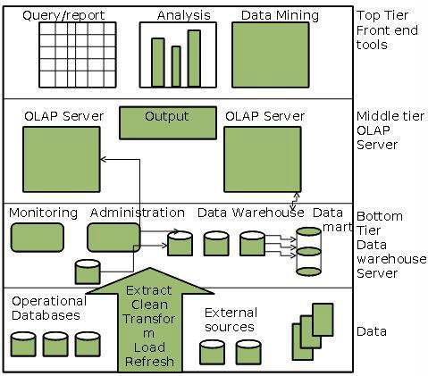
DATA WAREHOUSING - ARCHITECTURE
. The following diagram depicts the three-tier architecture of data warehouse:

Slide 30
DATA WAREHOUSING - OLAP
Online Analytical Processing Server OLAP is based on the multidimensional data model. It allows managers, and analysts to get an insight of the information through fast, consistent, and interactive access to information.
Types of OLAP Servers
We have four types of OLAP servers:
Relational OLAP ROLAP
Multidimensional OLAP MOLAP
Hybrid OLAP HOLAP
Specialized SQL Servers

Slide 31
DATA WAREHOUSING - OLAP
Relational OLAP
ROLAP servers are placed between relational back-end server and client front-end tools. To store and manage warehouse data, ROLAP uses relational or extended-relational DBMS. ROLAP includes the following:
  Implementation of aggregation navigation logic.
  Optimization for each DBMS back end.
Multidimensional OLAP
MOLAP uses array-based multidimensional storage engines for multidimensional views of data.
With multidimensional data stores, the storage utilization may be low if the data set is sparse. Therefore, many MOLAP server use two levels of data storage representation to handle dense and sparse data sets.

Slide 32
DATA WAREHOUSING - OLAP
Hybrid OLAP HOLAP
Hybrid OLAP is a combination of both ROLAP and MOLAP. It offers higher scalability of ROLAP and faster computation of MOLAP.
HOLAP servers allows to store the large data volumes of detailed information. The aggregations are stored separately in MOLAP store.
Specialized SQL Servers
Specialized SQL servers provide advanced query language and query processing support for SQL queries over star and snowflake schemas in a read-only environment.

Slide 33
DATA WAREHOUSING - SCHEMAS
Schema is a logical description of the entire database. It includes the name and description of records of all record types including all associated data-items and aggregates.
Much like a database, a data warehouse also requires to maintain a schema. A database uses relational model, while a data warehouse uses Star, Snowflake, and Fact Constellation schema. In this chapter, we will discuss the schemas used in a data warehouse.
Star Schema
Each dimension in a star schema is represented with only one-dimension table. This dimension table contains the set of attributes.
The following diagram shows the sales data of a company with respect to the four dimensions, namely time, item, branch, and location.

Slide 34
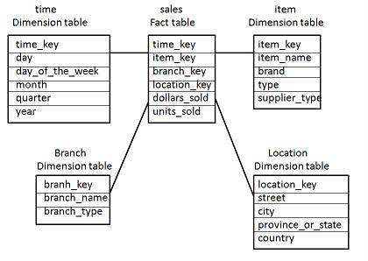
DATA WAREHOUSING - SCHEMAS
.

Slide 35
DATA WAREHOUSING - SCHEMAS
There is a fact table at the center. It contains the keys to each of four dimensions. The fact table also contains the attributes, namely dollars sold and units sold.
Note: Each dimension has only one dimension table and each table holds a set of attributes. For example, the location dimension table contains the attribute set {location_key, street, city, province_or_state,country}. This constraint may cause data redundancy.
For example, "Vancouver" and "Victoria" both the cities are in the Canadian province of British Columbia. The entries for such cities may cause data redundancy along the attributes province_or_state and country.

Slide 36
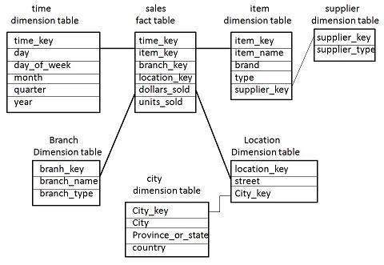
DATA WAREHOUSING - SCHEMAS
Snowflake Schema
Some dimension tables in the Snowflake schema are normalized. The normalization splits up the data into additional tables.
Unlike Star schema, the dimensions table in a snowflake schema are normalized. For example, the item dimension table in star schema is normalized and split into two dimension tables, namely item and supplier table.

Slide 37
DATA WAREHOUSING - SCHEMAS
Now the item dimension table contains the attributes item_key, item_name, type, brand, and supplier-key.
The supplier key is linked to the supplier dimension table. The supplier dimension table contains the attributes supplier_key and supplier_type.
Note: Due to normalization in the Snowflake schema, the redundancy is reduced and therefore, it becomes easy to maintain and the save storage space.
Fact Constellation Schema
A fact constellation has multiple fact tables. It is also known as galaxy schema. The following diagram shows two fact tables, namely sales and shipping.

Slide 38
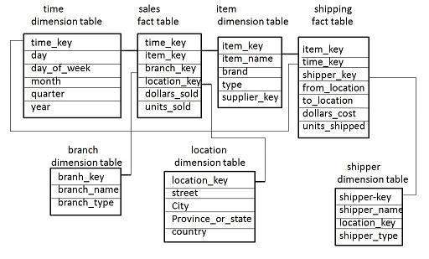
DATA WAREHOUSING - SCHEMAS
.

Slide 39
DATA WAREHOUSING - SCHEMAS
The sales fact table is same as that in the star schema. The shipping fact table has the five dimensions, namely item_key, time_key, shipper_key, from_location, to_location.
The shipping fact table also contains two measures, namely dollars sold and units sold.
It is also possible to share dimension tables between fact tables. For example, time, item, and location dimension tables are shared between the sales and shipping fact table.

Slide 40
OLAP Operations
Since OLAP servers are based on multidimensional view of data, we will discuss OLAP operations in multidimensional data.
Here is the list of OLAP operations:
Roll-up
Drill-down
Slice and dice
Roll-up
Roll-up performs aggregation on a data cube in any of the following ways:
By climbing up a concept hierarchy for a dimension
By dimension reduction
The following diagram illustrates how roll-up works.

Slide 41
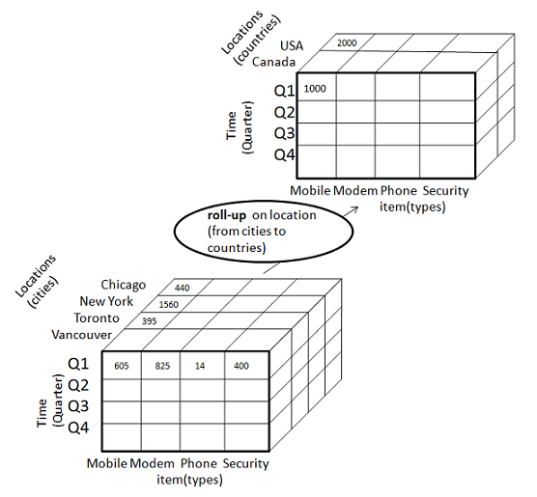
OLAP Operations
.

Slide 42
OLAP Operations
Roll-up is performed by climbing up a concept hierarchy for the dimension location.
Initially the concept hierarchy was "street < city < province < country".
On rolling up, the data is aggregated by ascending the location hierarchy from the level of city to the level of country.
The data is grouped into cities rather than countries.
When roll-up is performed, one or more dimensions from the data cube are removed.

Slide 43
OLAP Operations
Drill-down
Drill-down is the reverse operation of roll-up. It is performed by either of the following ways:
By stepping down a concept hierarchy for a dimension
By introducing a new dimension.
The following diagram illustrates how drill-down works:

Slide 44
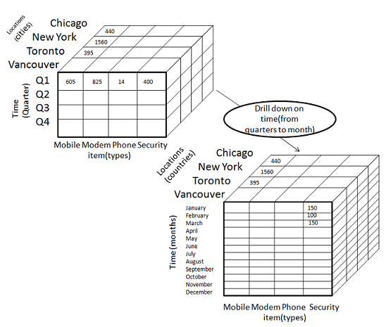
OLAP Operations
.

Slide 45
OLAP Operations
Drill-down is performed by stepping down a concept hierarchy for the dimension time.
Initially the concept hierarchy was "day < month < quarter < year."
On drilling down, the time dimension is descended from the level of quarter to the level of month.
When drill-down is performed, one or more dimensions from the data cube are added.
It navigates the data from less detailed data to highly detailed data.
Slice
The slice operation selects one particular dimension from a given cube and provides a new sub cube.
Consider the following diagram that shows how slice works.

Slide 46
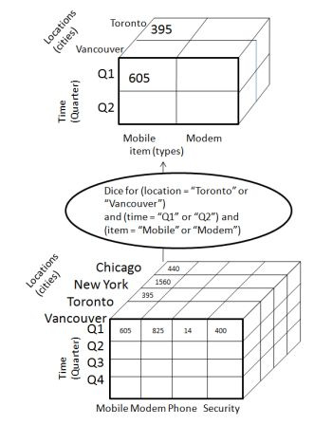
OLAP Operations
.

Slide 47
OLAP Operations
The dice operation on the cube based on the following selection criteria involves three
dimensions.
location = "Toronto" or "Vancouver"
time = "Q1" or "Q2"
item =" Mobile" or "Modem"
Pivot
The pivot operation is also known as rotation. It rotates the data axes in view in order to provide an alternative presentation of data.
Consider the following diagram that shows the pivot operation.

Slide 48
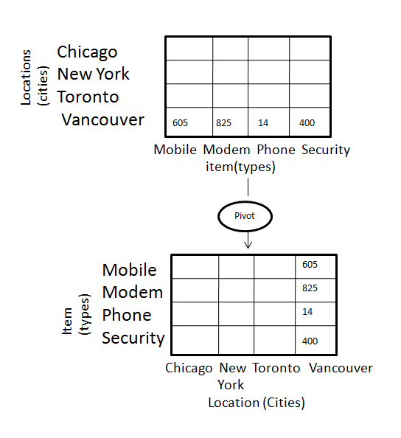
OLAP Operations
.

Slide 49
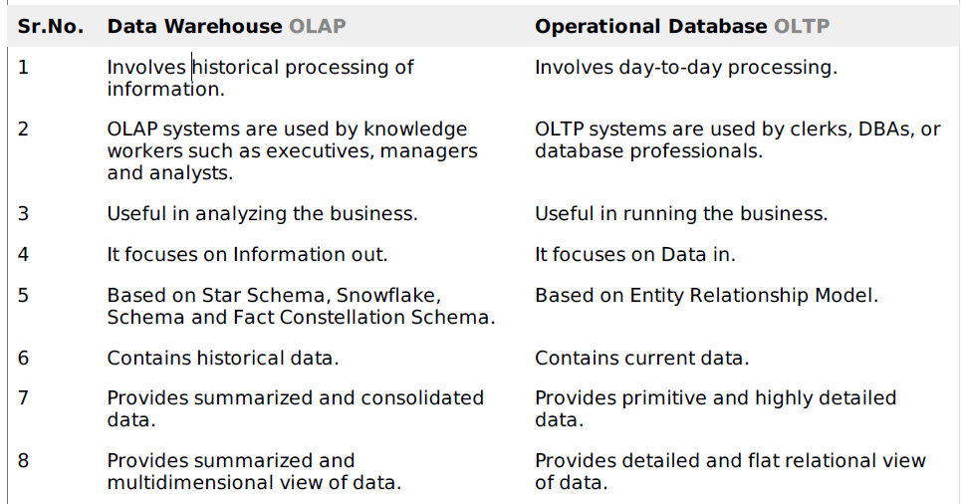
OLAP vs OLTP
.

Slide 50
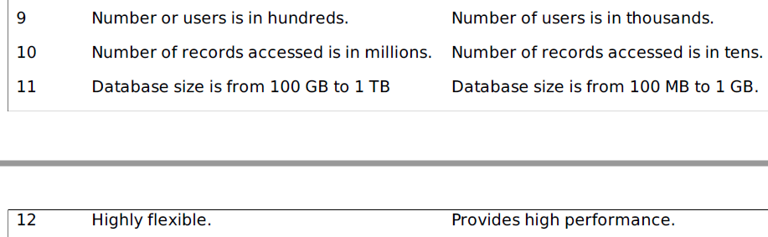
OLAP vs OLTP
.

Slide 51
THE END

