Slide 1
Selected Topics in Computer Science
Chapter 2
Data Mining

Slide 2
Out lines
Introduction to Data Mining
Data Mining process
Data Mining Applications
Knowledge Discovery in Databases(KDD)
Data Mining Tasks

Slide 3
Introduction to Data Mining
There is a huge amount of data available in the Information Industry.
This data is of no use until it is converted into useful information. It is necessary to analyze this huge amount of data and extract useful information from it.
Data Mining is defined as extracting information from huge sets of data. In other words, we can say that data mining is the procedure of mining knowledge from data.

Slide 4
Data Mining Process
Data Mining is a process of discovering various models, summaries, and derived values from a given collection of data.
The general experimental procedure adapted to data-mining problems involves the following steps:
State the problem and formulate the hypothesis:
Most data-based modeling studies are performed in a particular application domain. Hence, domain-specific knowledge and experience are usually necessary in order to come up with a meaningful problem statement.

Slide 5
Data Mining Process
2. Data Collection:
This step is concerned with how the data are generated and collected. These data's may be primary or secondary.
3. Preprocessing the data:
In the observational setting, data are usually "collected" from the existing databases, data warehouses, and data marts. Data preprocessing usually includes at least two common tasks:
Outlier detection (and removal): Outliers are unusual data values that are not consistent with most observations. Commonly, outliers result from measurement errors, coding and recording errors, and, sometimes, are natural, abnormal values.
Scaling, encoding, and selecting features: Data preprocessing includes several steps such as variable scaling and different types of encoding.

Slide 6
Data Mining Process
4. Estimate the model
The selection and implementation of the appropriate data-mining technique is the main task in this phase.
This process is not straightforward; usually, in practice, the implementation is based on several models, and selecting the best one is an additional task.

Slide 7
Data Mining Process
5. Interpret the model and draw conclusions :
In most cases, data-mining models should help in decision making. Hence, such models need to be interpretable in order to be useful.
Note that the goals of accuracy of the model and accuracy of its interpretation are somewhat contradictory. Usually, simple models are more interpretable, but they are also less accurate.
Modern data-mining methods are expected to yield highly accurate results using high dimensional models.

Slide 8
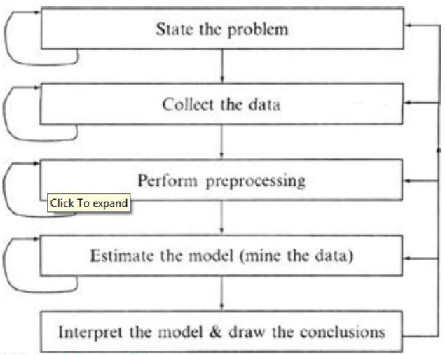
Data Mining Process
.
The Data mining Process

Slide 9
Data Mining Applications
Data mining is highly useful in the following domains:
Market Analysis and Management
Corporate Analysis & Risk Management
Fraud Detection
Apart from these, data mining can also be used in the areas of production control, customer retention, science exploration….
Market Analysis and Management:
1. Identifying Customer Requirements - Data mining helps in identifying the best products for different customers. It uses prediction to find the factors that may attract new customers.
2. Cross Market Analysis - Data mining performs Association/correlations between product sales.
3. Target Marketing - Data mining helps to find clusters of model customers who share the same characteristics such as interests, spending habits, income, etc.

Slide 10
Data Mining Applications
4. Determining Customer purchasing pattern - Data mining helps in determining customer purchasing pattern.
5. Providing Summary Information - Data mining provides us various multidimensional summary reports.
Corporate Analysis and Risk Management :
Data mining is used in the following fields of the Corporate Sector:
Finance Planning and Asset Evaluation - It involves cash flow analysis and prediction, contingent claim analysis to evaluate assets.
Resource Planning - It involves summarizing and comparing the resources and spending.
Competition - It involves monitoring competitors and market directions.

Slide 11
Data Mining Applications
Fraud Detection :
Data mining is also used in the fields of credit card services and telecommunication to detect frauds.
In fraud telephone calls, it helps to find the destination of the call, duration of the call, time of the day or week, etc. It also analyzes the patterns that deviate from expected norms.

Slide 12
Knowledge Discovery in Databases(KDD)
Some people treat data mining same as Knowledge discovery while some people view data mining essential step in process of knowledge discovery.Here is the list of steps involved in knowledge discovery process:
  Data Cleaning - In this step the noise and inconsistent data is removed.
  Data Integration - In this step multiple data sources are combined.
  Data Selection - In this step relevant to the analysis task are retrieved from the database.
  Data Transformation - In this step data are transformed or consolidated into forms appropriate for mining by performing summary or aggregation operations.

Slide 13
Knowledge Discovery in Databases(KDD)
    Data Mining - In this step intelligent methods are applied in order to extract data patterns.
    Pattern Evaluation - In this step, data patterns are evaluated.
    Knowledge Presentation - In this step, knowledge is represented.

Slide 14
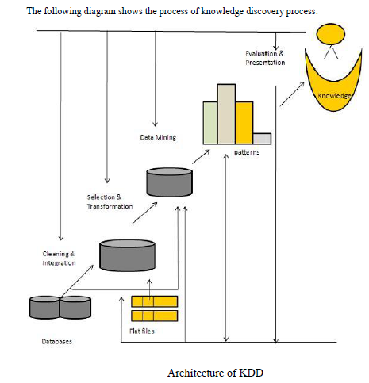
Knowledge Discovery in Databases(KDD)

Slide 15
Data Mining Tasks
Data mining deals with the kind of patterns that can be mined. On the basis of the kind of data to be mined, there are two categories of functions involved in Data Mining:
Descriptive
Classification and Prediction
Descriptive Function :The descriptive function deals with the general properties of data in the database. Here is the list of descriptive functions:
Class/Concept Description
Mining of Frequent Patterns
Mining of Associations
Mining of Correlations
Mining of Clusters

Slide 16
Data Mining Tasks
Class/Concept Description:
Class/Concept refers to the data to be associated with the classes or concepts. For example, in a company, the classes of items for sales include computer and printers, and concepts of customers include big spenders and budget spenders.
Such descriptions of a class or a concept are called class/concept descriptions. These descriptions can be derived by the following two ways:
Data Characterization - This refers to summarizing data of a class under study. This class under study is called as the Target Class.
Data Discrimination - It refers to the mapping or classification of a class with some predefined group or class.

Slide 17
Data Mining Tasks
Mining of Frequent Patterns :
Frequent patterns are those patterns that occur frequently in transactional data. Here is the list of kind of frequent patterns:
Frequent Item Set - It refers to a set of items that frequently appear together, for example, milk and bread.
Frequent Subsequence- A sequence of patterns that occur frequently such as purchasing a camera is followed by memory card.
Frequent Sub Structure - Substructure refers to different structural forms, such as graphs, trees, or lattices, which may be combined with item-sets or subsequences.

Slide 18
Data Mining Tasks
Mining of Association
Associations are used in retail sales to identify patterns that are frequently purchased together. This process refers to the process of uncovering the relationship among data and determining association rules. For example, a retailer generates an association rule that shows that 70% of time milk is sold with bread and only 30% of times biscuits are sold with bread.
Mining of Correlations
It is a kind of additional analysis performed to uncover interesting statistical correlations between associated-attribute-value pairs or between two item sets to analyze that if they have positive, negative or no effect on each other.

Slide 19
Data Mining Tasks
Mining of Clusters :
Cluster refers to a group of similar kind of objects. Cluster analysis refers to forming group of objects that are very similar to each other but are highly different from the objects in other clusters.

Slide 20
Data Mining Tasks
Classification and Prediction
Classification is the process of finding a model that describes the data classes or concepts. The purpose is to be able to use this model to predict the class of objects whose class label is unknown.
This derived model is based on the analysis of sets of training data. The derived model can be presented in the following forms:
  Classification (IF-THEN) Rules
  Decision Trees
  Mathematical Formulae
  Neural Networks

Slide 21
Data Mining Tasks
The list of functions involved in these processes are as follows:
Classification - It predicts the class of objects whose class label is unknown. Its objective is to find a derived model that describes and distinguishes data classes or concepts.
The Derived Model is based on the analysis set of training data i.e. the data object whose class label is well known.
Prediction - It is used to predict missing or unavailable numerical data values rather than class labels. Regression Analysis is generally used for prediction.
Prediction can also be used for identification of distribution trends based on available data.
Outlier Analysis - Outliers may be defined as the data objects that do not comply with the general behavior or model of the data available.
Evolution Analysis - Evolution analysis refers to the description and model regularities or trends for objects whose behavior changes over time.

Slide 22
THE END

