Slide 1
Selected Topics in Computer Science
GIS (Geographic Information System)
Chapter Four

Slide 2
GIS (Geographic Information System)
Chapter Four
Geographical Information system (GIS) are computer based system that enable users to collect, store, process and analyses and present spatial data.
It provides an electronic representation of information called spatial data, about the earth’s natural and man-made features.
A GIS system stores each category of information in a separate layer for ease of maintenance, visualization and analysis.

Slide 3
Cont.
Chapter Four
A geographic information system (GIS) is a computer system for capturing, storing, checking, and displaying data related to positions on Earth’s surface.
GIS can show many different kinds of data on one map, such as streets, buildings, and vegetation.
This enables people to more easily see, analyze, and understand patterns and relationships.

Slide 4
Cont.
Chapter Four
A geographic information system (GIS) is a computer system for capturing, storing, checking, and displaying data related to positions on Earth’s surface.
GIS can show many different kinds of data on one map, such as streets, buildings, and vegetation.
This enables people to more easily see, analyze, and understand patterns and relationships.

Slide 5
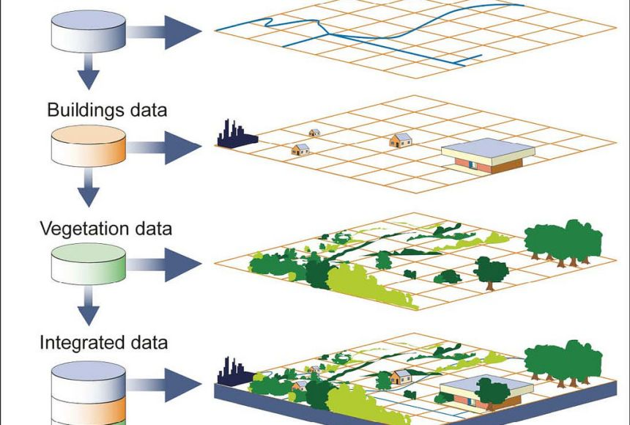
Cont.
Chapter Four
.

Slide 6
Cont.
Chapter Four
GIS can use any information that includes location.
The location can be expressed in many different ways, such as latitude and longitude, address…
GIS must make the information from all the various maps and sources align, so they fit together on the same scale.
A scale is the relationship between the distance on a map and the actual distance on Earth.

Slide 7
GIS Tasks
Chapter Four
Scientists use GIS to compare population statistics to resources such as drinking water.
Biologists use GIS to track animal migration patterns.
City, state, or federal officials use GIS to help plan their response in the case of a natural disaster such as an earthquake or hurricane.
GIS maps can show these officials what neighborhoods are most in danger, where to locate emergency shelters, and what routes people should take to reach safety.
Engineers may use GIS to develop road networks and transportation infrastructure.
Generally There is no limit to the kind of information that can be analyzed using GIS technology.

Slide 8
Types of GIS
Chapter Four
Multimedia/hypermedia GIS allow the user to access a wide range of georeferenced multimedia data (e.g., simulations, digital and analogue video and animation).
Multimedia provides communication using texts, graphics, animation and video.
Multimedia GIS systems is a way to overcome the limitations displayed by the technologies when they are used separately.

Slide 9
Types of GIS
Chapter Four
Web GIS
Widespread access to the Internet, the ubiquity of browsers and the explosion of commodified geographic information has made it possible to develop new forms of multimedia geo-representations on the Web.
for example, provides a good range of Internet mapping solutions based on their RouteMAP IMS(Internet Mapping Server) architectures.

Slide 10
Types of GIS
Chapter Four
Virtual Reality GIS
Virtual Reality GIS have been developed to allow the creation, manipulation and exploration of geo-referenced virtual environments.
4D GIS
These aspects have made 4D GIS increasingly needed as a real-time platform that also offers not just current monitoring of events but can take input or data gathered and predict what could happen as a type of forecasting tool.
As an example, GPS data may indicate a current path for a vehicle, but knowing where that vehicle is likely to go would require knowledge perhaps about past behavior or other attributes that enable prediction to be possible.

Slide 11
GIS Subsystems
Chapter Four
A GIS has four main functional subsystems. These are:
a data input subsystem
a data storage and retrieval subsystem
a data manipulation and analysis subsystem
a data output and display subsystem.

Slide 12
GIS Subsystems
Chapter Four
Data Input: A data input subsystem allows the user to capture, collect, and transform spatial and thematic data into digital form.
The data inputs are usually derived from a combination of hard copy maps, aerial photographs, remotely sensed images, reports, survey documents. .
Data Storage and Retrieval: The data storage and retrieval subsystem organizes the data, spatial and attribute, in a form which permits it to be quickly retrieved by the user for analysis, and permits rapid and accurate updates to be made to the database.
This component usually involves use of a database management system (DBMS) for maintaining attribute data.

Slide 13
GIS Subsystems
Chapter Four
Data Manipulation and Analysis: The data manipulation and analysis subsystem allows the user to define and execute spatial and attribute procedures to generate derived information.
This subsystem is commonly thought of as the heart of a GIS
Data Output: The data output subsystem allows the user to generate graphic displays, normally maps, and tabular reports representing derived information products.

Slide 14
Selected Topics in Computer Science
Chapter 5
Cloud Computing

Slide 15
Introduction to Cloud Computing
Chapter Five
The term Cloud refers to a Network or Internet.
In other words, we can say that Cloud is something, which is present at remote location.
Cloud can provide services over network, i.e., on public networks or on private networks, i.e., WAN, LAN…
Applications such as e-mail, web conferencing, customer relationship management (CRM),all run in cloud.
Cloud Computing provides us a means by which we can access the applications as utilities, over the Internet.
It allows us to create, configure, and customize applications online.

Slide 16
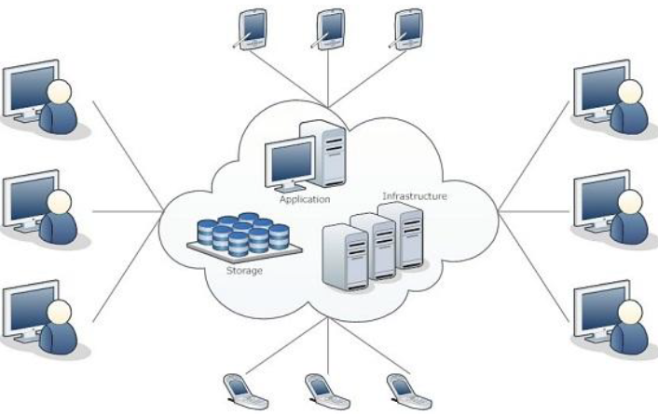
Introduction to Cloud Computing
Chapter Five
Cloud Computing refers to manipulating, configuring, and accessing the applications online. It offers online data storage, infrastructure and application.

Slide 17
Introduction to Cloud Computing
Chapter Five
There are certain services and models working behind the scene making the cloud computing feasible and accessible to end users.
Following are the working models for cloud computing:
  Deployment Models
  Service Models
Deployment Models
Deployment models define the type of access to the cloud.
Cloud can have any of the four types of access: Public, Private, Hybrid and Community.

Slide 18
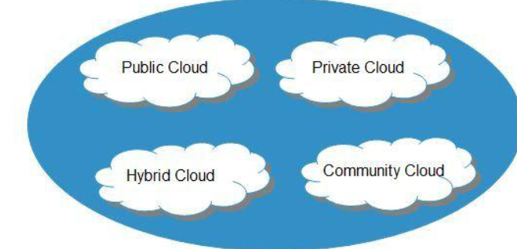
Introduction to Cloud Computing
Chapter Five
.

Slide 19
Introduction to Cloud Computing
Chapter Five
Public Cloud
The Public Cloud allows systems and services to be easily accessible to the general public.
Public cloud may be less secure because of its openness.
Private Cloud
The Private Cloud allows systems and services to be accessible within an organization. It offers increased security because of its private nature.

Slide 20
Introduction to Cloud Computing
Chapter Five
Community Cloud
The Community Cloud allows systems and services to be accessible by group of organizations.
Hybrid Cloud
The Hybrid Cloud is mixture of public and private cloud. However, the critical activities are performed using private cloud while the non-critical activities are performed using public cloud.

Slide 21
Introduction to Cloud Computing
Chapter Five
SERVICE MODELS
Service Models are the reference models on which the Cloud Computing is based.
These can be categorized into three basic service models as listed below:
    Infrastructure as a Service (IaaS)
    Platform as a Service (PaaS)
    Software as a Service (SaaS)

Slide 22
Introduction to Cloud Computing
Chapter Five
There are many other service models all of which can take the form like XaaS, i.e., Anything as a Service.
This can be Network as a Service, Business as a Service, Identity as a Service, Database as a Service or Strategy as a Service.
The Infrastructure as a Service (IaaS) is the most basic level of service.
Each of the service models make use of the underlying service model, i.e., each inherits the security and management mechanism from the underlying model, as shown in the following diagram:

Slide 23
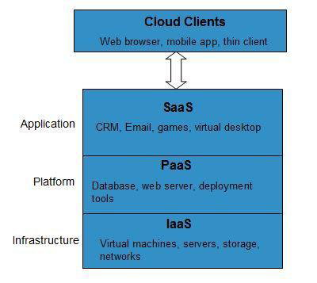
Introduction to Cloud Computing
Chapter Five
.

Slide 24
Introduction to Cloud Computing
Chapter Five
Infrastructure As A Service (Iaas)
IaaS provides access to fundamental resources such as physical machines, virtual machines, virtual storage, etc.
Platform As A Service (Paas)
PaaS provides the runtime environment for applications, development & deployment tools, etc.
Software As A Service (Saas)
SaaS model allows to use software applications as a service to end users.

Slide 25
Introduction to Cloud Computing
Chapter Five
Infrastructure As A Service (Iaas)
IaaS provides access to fundamental resources such as physical machines, virtual machines, virtual storage, etc.
Platform As A Service (Paas)
PaaS provides the runtime environment for applications, development & deployment tools, etc.
Software As A Service (Saas)
SaaS model allows to use software applications as a service to end users.

Slide 26
Introduction to Cloud Computing
Chapter Five
Reading Assignment
Advantage, Disadvantage and challenges in Cloud computing

