Slide 1

DEBRE MARKOS UNIVERSITY
BURIE CAMPUS
DEPARTMENT OF COMPUTER SCIENCE
Software Engineering
By:
Amare W.

Slide 2
Chapter Five: Analysis
Analysis Concepts
Analysis focuses on producing a model of the system, called the analysis model, which is correct, complete, consistent and verifiable.
Analysis is different from requirement elicitation in that developers focus on structuring and formalizing the requirements elicited from users.
The analysis model may not be understandable to the users and the client, developers need to update the requirements specification to reflect insights gained during analysis.
Then review the changes with the client and the users and however it is large, should be understandable by the user.

Slide 3
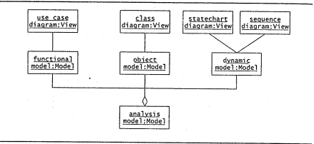
The analysis model is composed of three individual models: the functional model, represented by use cases and scenarios, the analysis object model, represented by class and object diagrams, and the dynamic model, represented by statechart and sequence diagrams.

Slide 4
Entity, Boundary and Control objects
The analysis object model consists of Entity, Boundary and Control objects. Entity objects represent the persistent information tracked by the system.
Boundary objects represent the interactions between the actors and the system. Control objects are in charge of realizing use cases.
To distinguish between different types of objects, UML provides stereotype mechanism to enable the developer to attach such meta-information to modeling elements.

Slide 5
In addition to stereotypes, we may also use naming conventions for clarity and recommend distinguishing the three different types of objects on a syntactical base.
Control object may have the suffix control append to their name; boundary objects may be named to clearly denote an interface feature (by including the suffix form, button or display); entity object usually do not have any suffix appended to their name.

Slide 6
Generalization and Specialization
Inheritance enables us to organize concepts into hierarchies. At the top of the hierarchy is a general concept and at the bottom of the hierarchy are the most specialized concepts.
Generalization is the modeling activity that identifies abstract concepts from lower level one.
Specialization is the activity that identifies more specific concepts from high level one.
In both cases, generalization and specialization result in the specification of inheritance relationships between concepts.

Slide 7
Analysis Activities: From Use Case to Objects
Activities that transform the use cases and scenarios produced during requirement elicitation into an analysis model.
Analysis activities include:
Identifying entity objects
Identifying boundary objects
Identifying control objects
Mapping use cases to objects with sequence diagrams
Modelling interactions between objects
Identifying associations
Identifying attributes

Slide 8
Identifying Entity Objects
Participating objects form the basis of the analysis model. As described in requirements elicitation, participating objects are found by examining each use case and identifying candidate objects.
Natural language analysis [Abbott, 1983] is an intuitive set of heuristics for identifying objects, attributes, and associations from requirement specification.
Developers name and briefly describe the objects, their attributes and their responsibilities as they are identified.
For entity objects we recommend always start with the names used by end users and application domain specialists.

Slide 9
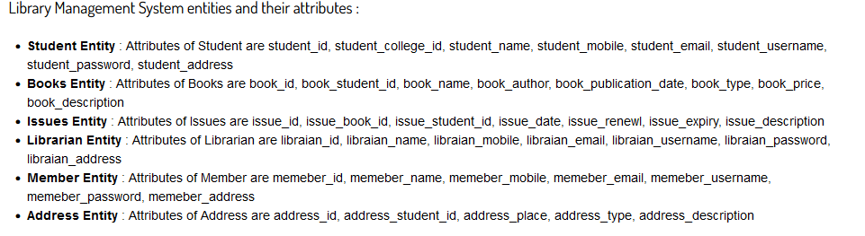

Slide 10
Identifying Boundary Objects
Boundary objects represent the system interface with the actors. In each use case, each actor interacts with at least one boundary object.
The boundary object collects information from the actor and translates it into a form that can be used by both entity and control objects.
Boundary objects model the user interface at a coarse level.

Slide 11
Heuristics for identifying boundary objects.
Identify user interface controls that the user needs to initiate the use case.
Identify forms the users needs to enter data into the system.
Identify notices and messages the system uses to respond to the user.
When multiple actors are involved in a use case, identify actor terminals.
Always use the end user’s terms for describing interfaces; do not use terms from the solution or implementation domains.

Slide 12
Identifying Control Objects
Control objects are responsible for coordinating boundary and entity objects.
A control object is usually created at the beginning of the use case and ceases to exist at its end.
It is responsible for collecting information from the boundary objects and dispatching it to entity objects.

Slide 13
Heuristics for identifying control objects.
Identify one control object per use case.
Identify one control object per actor in the use case.
The life span of a control object should cover the extent of the use case or the extent of the a user session.

Slide 14
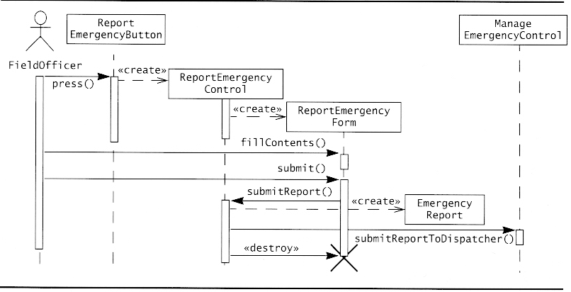
Mapping use cases to objects with sequence diagrams
A sequence diagram ties use case with objects. It shows how the behaviour of the use case (scenario) is distributed among its participating objects.

Slide 15
As shown from previous Figures sequence diagrams associated with the ReportEmergency use case.
The columns of a sequence diagram represent the objects that participate in the use case.
The left-most column is the actor who initiates the use case. Horizontal arrows across columns represent messages, or stimuli, that are sent from one object to the other.
Time proceeds vertically from top to bottom. The first arrow in the Figure represents the press message sent by a FieldOfficer to an ReportEmergencyButton.

Slide 16
The receipt of a message triggers the activation of an operation. The activation is represented by a vertical rectangle from which other messages can originate.
The length of the rectangle represents the time the operation is active. In the Figure, the operation triggered by the press message sends a create message to the ReportEmergencyControl class.
Objects that are created during the interaction are depicted with the «create» message pointing to the object.
Instances that are destroyed during the interaction have a cross indicating when the object ceases to exist.

Slide 17
Between the rectangle representing the object and the cross (or the bottom of the diagram, if the object survives the interaction), a dashed line represents the time span when the object can receive messages.
The object cannot receive messages below the cross sign. For example, in the Figure an object of class ReportEmergencyForm is created when object of ReportEmergencyControl sends the «create» message and is destroyed once the EmergencyReportForm has been submitted.

Slide 18
Heuristics for drawing sequence diagrams
The first column should correspond to the actor who initiated the use case.
The second column should be a boundary object (that the actor used to initiate the use case).
The third column should be the control object that manages the rest of the use cases.
Control objects are created by boundary objects initiating use cases.
Boundary objects are created by control objects.
Entity objects are accessed by control and boundary objects.
Entity objects never access boundary or control objects;

Slide 19
  Modelling Interactions between objects
An alternative for identifying interactions among objects are CRC cards [Beck and Cunningham, 1989].
CRC stands for class, Responsibilities, and Collaborators.
Each class is represented with an index card (called the CRC card).
The name of the class is depicted on the top, its responsibilities in the left column, and the names of the classes it needs to accomplish its responsibilities are depicted in the right column.

Slide 20
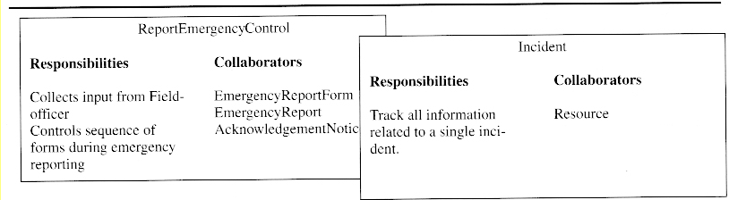

Slide 21
Identifying Associations
An association shows a relationship between two or more classes. Identifying associations has two advantages:
First, it clarifies the analysis model by making relationships between objects explicitly.
Second, it enables the developer to discover boundary cases associated with links. Associations have several properties:
A name to describe the association between two classes. Association names are optional and need not be unique globally.

Slide 22
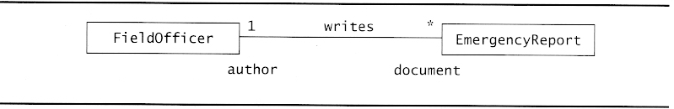
A role at each end, identifying the function of each class with respect to the associations.
A multiplicity at each end, identifying the possible number of instances (* indicates a Fieldofficer may write zero or more, EmergencyReports whereas 1 indicates that each EmergencyReports has exactly one Fieldofficer as author).

Slide 23
According to Abbott’s heuristics, associations can be identified by examining verbs and verb phrases denoting a state (eg. has, is part of, manages, reports to, is triggered by, is contained in, talks to, includes).
Every association should be named and roles should be assigned to each end.

Slide 24
Identifying Attributes
Attributes are properties of objects. When identifying properties of objects, only the attributes relevant to the system should be considered.
Properties that are represented by objects are not attributes.
Developers should identify as many associations as possible before identifying attributes to avoid confusing attributes and objects.
Attributes have name, brief description and type.

Slide 25
Heuristics for identifying attributes
Examine possessive phrases
Represent stored state as an attribute of the entity object
Describe each attribute
Do not represent an attribute as an object; use an association instead.

Slide 26

Thank you

