Slide 1
Chapter-6
6.1 Introduction to Computability
A computation is any type of calculation includes both arithmetical and non-arithmetical steps and which follows a well-defined model (e.g. an algorithm)
Computation is defined as the execution sequences of halting Turing machines.
The theory of computation is a branch of computer science and mathematics combined that "deals with how efficiently problems can be solved on a model of computation, using an algorithm".
Computational problems can be decision problems, search problems, optimization problems, and counting problems.

Slide 2
Computability Theory will deal with the following questions:
  What is a computation?
  Can we come up with a precise definition of an algorithm or a computation? (The answer is yes).
  Can everything be computed? (The answer is no.)
  Can we characterize problems that cannot be computed? (The answer is it is hard to do that but in certain cases we can identify them and prove that they are not computable).
Computability is the ability to solve a problem in an effective manner.
The computability of a problem is closely linked to the existence of an algorithm to solve the problem.

Slide 3
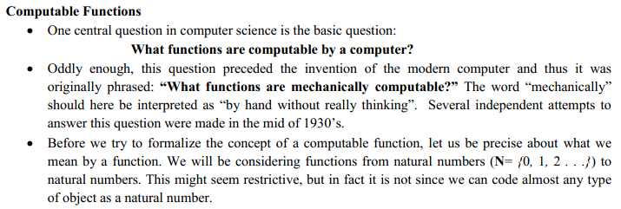
6.2 Recursive Functions

Slide 4
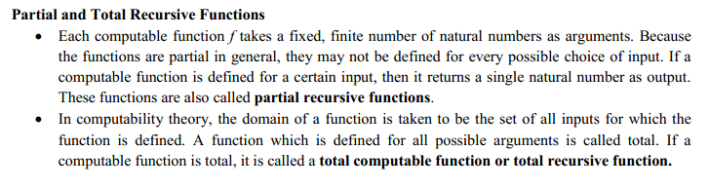

Slide 5
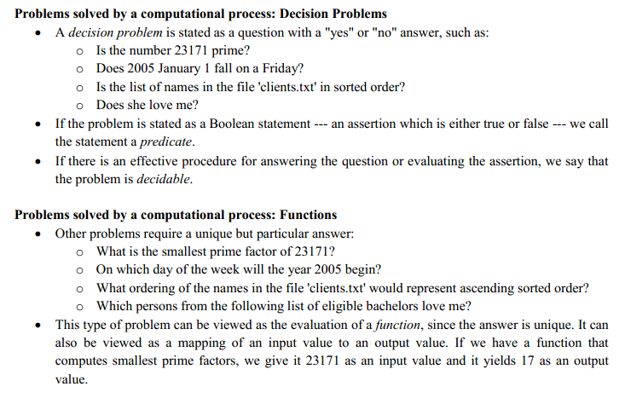

Slide 6
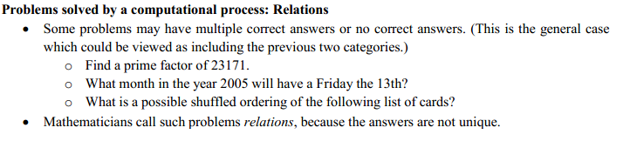
Conti…

Slide 7


Slide 8
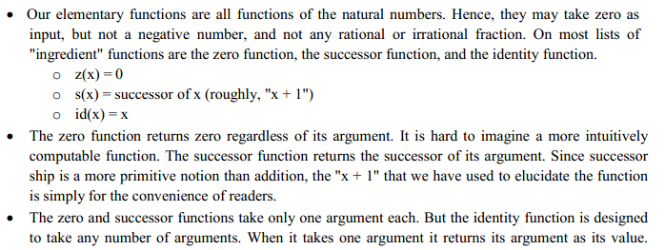

Slide 9
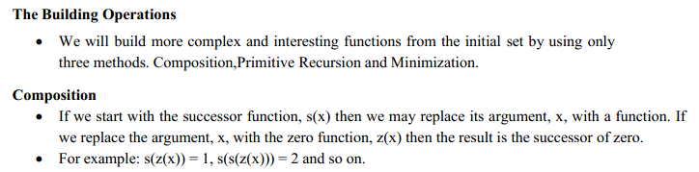

Slide 10
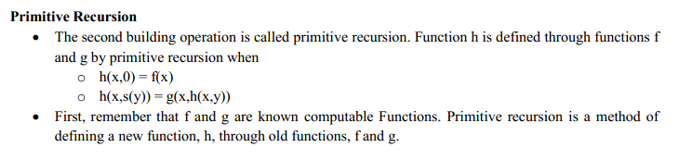

Slide 11
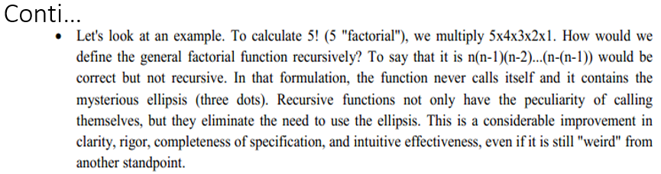

Slide 12
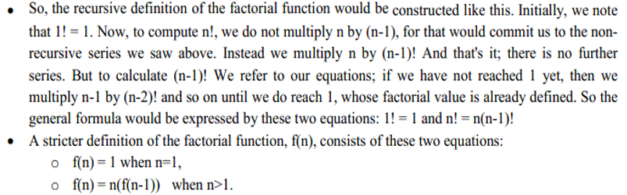
Conti…

Slide 13
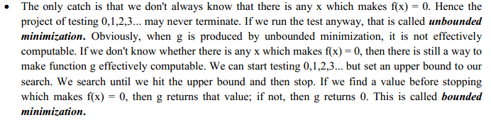

Slide 14
6.3 Recursively Enumerable
and
Regular Languages

Slide 15
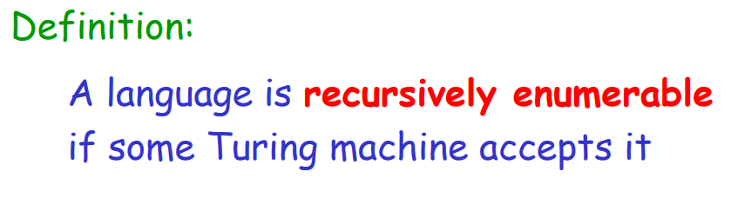

Slide 16
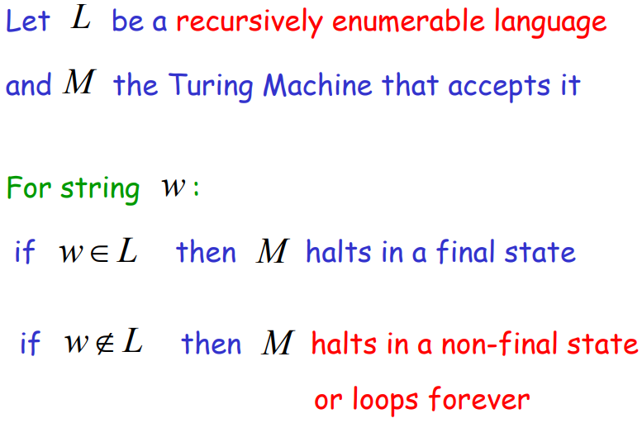
Conti…

Slide 17
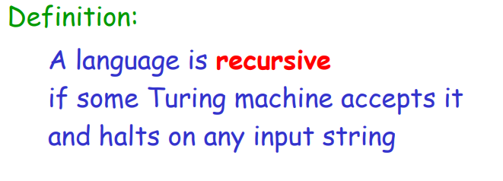

Slide 18
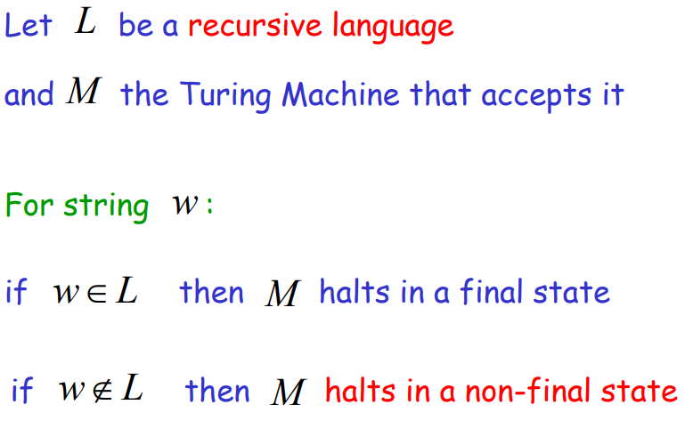
Conti…

Slide 19
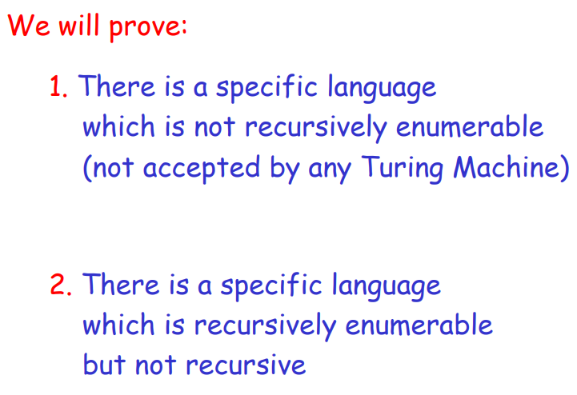

Slide 20
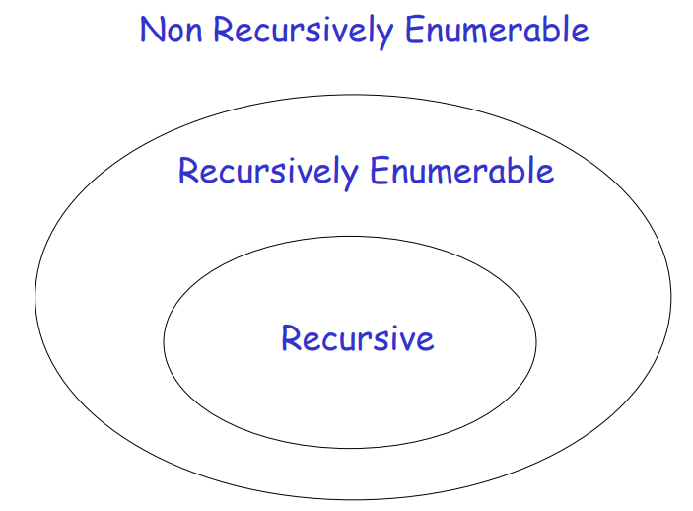

Slide 21
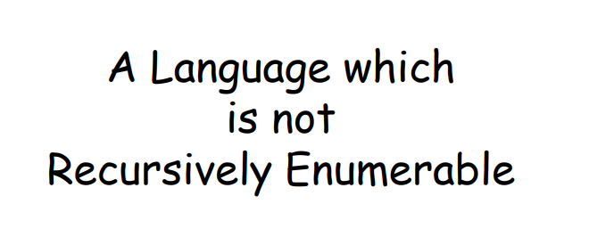

Slide 22
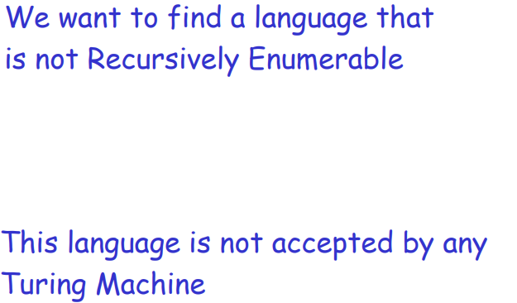
Conti…

Slide 23
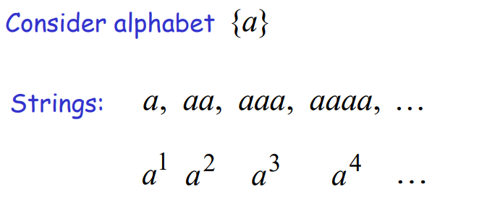
Conti…

Slide 24
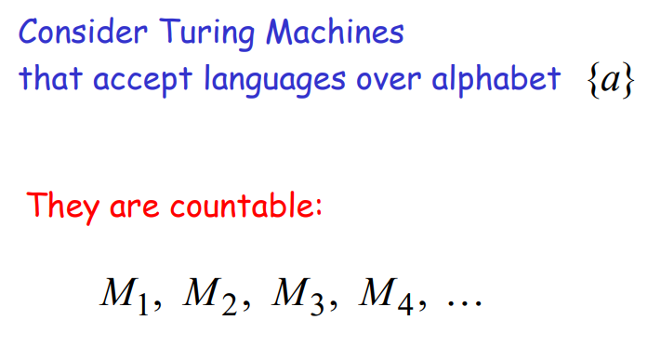

Slide 25
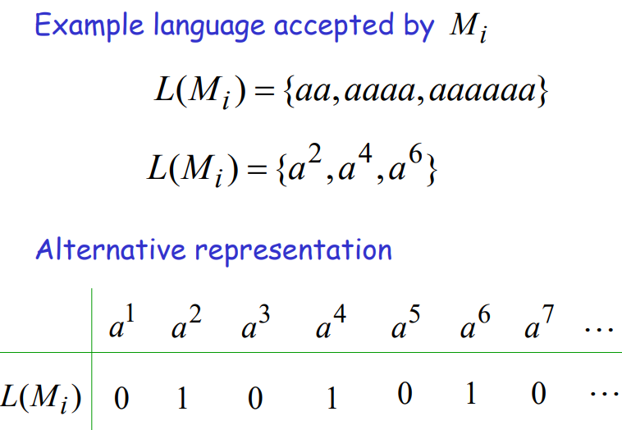

Slide 26
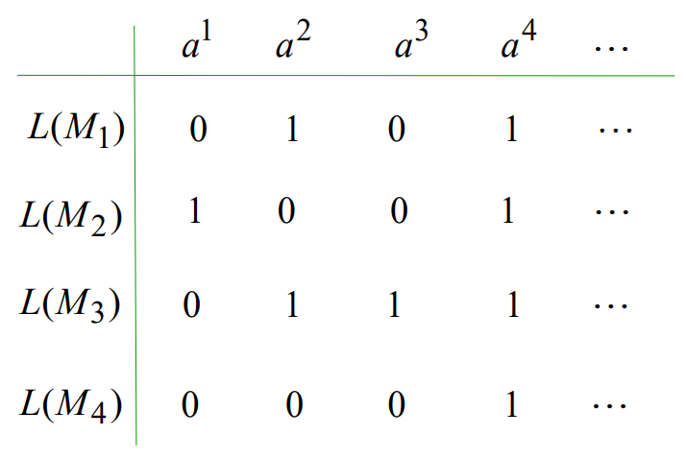
Conti…

Slide 27
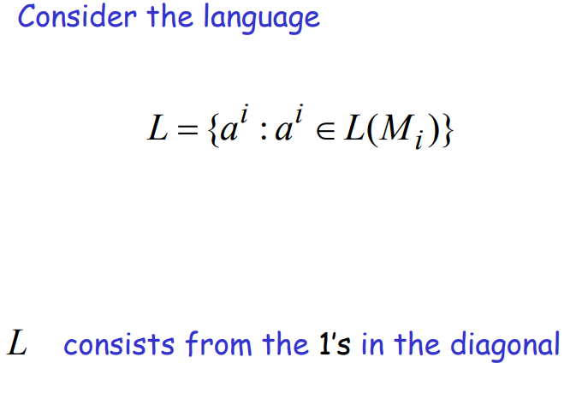

Slide 28
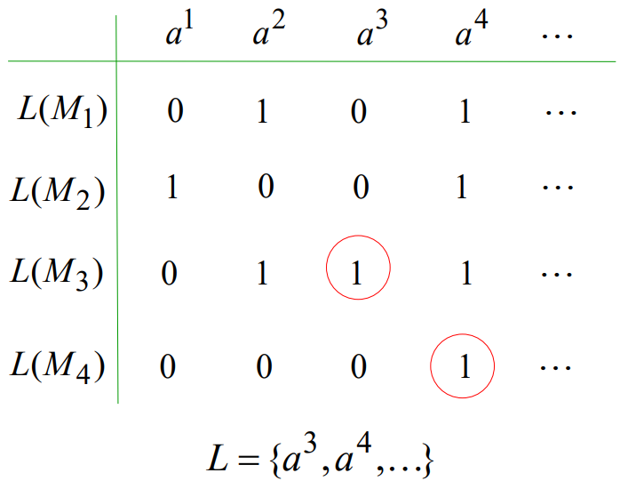
Conti…

Slide 29
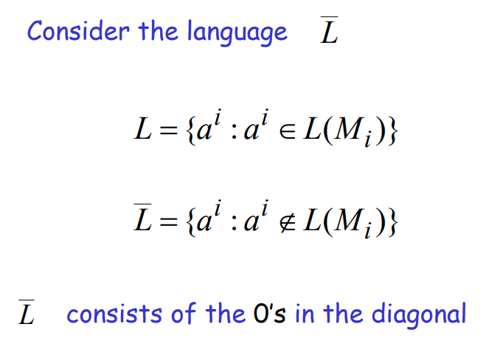

Slide 30
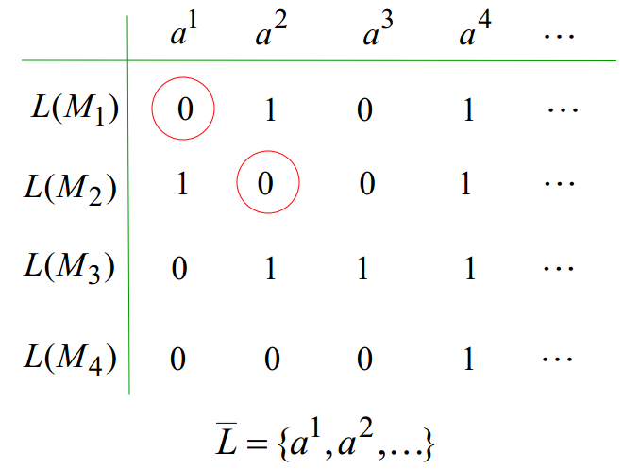
Conti…

Slide 31
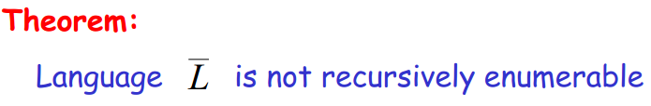
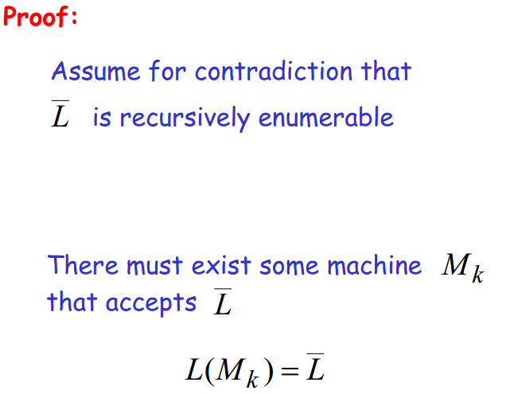

Slide 32
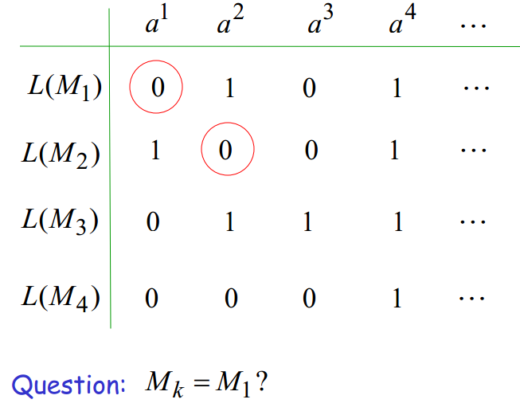

Slide 33
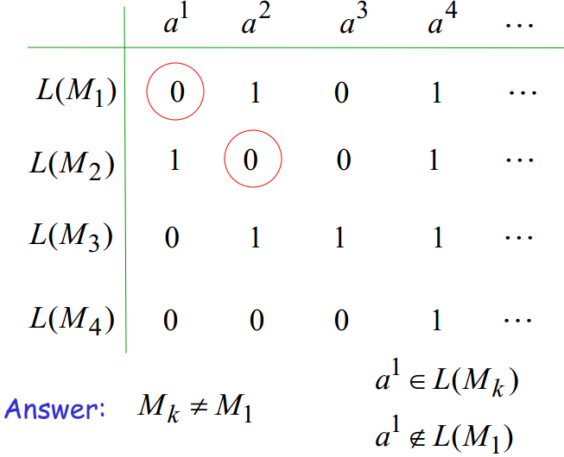
Conti…

Slide 34
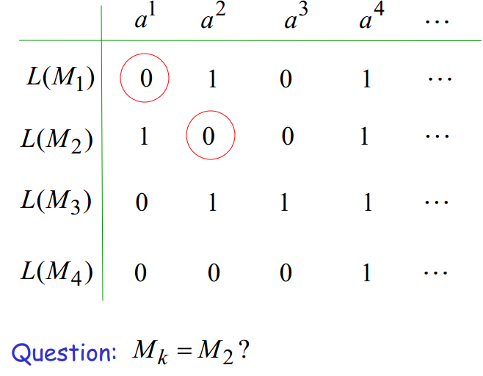

Slide 35

Conti…

Slide 36
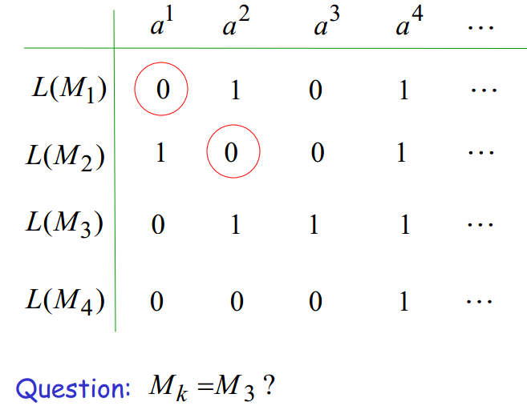

Slide 37
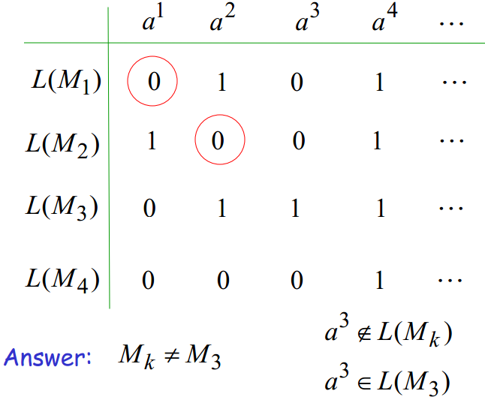
Conti…

Slide 38
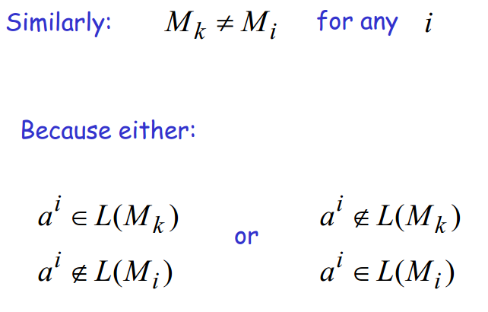

Slide 39
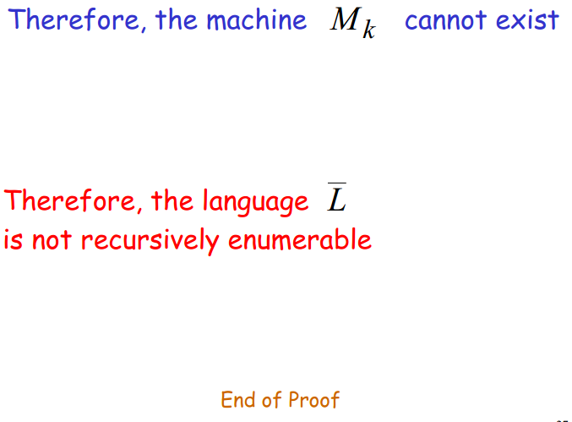

Slide 40
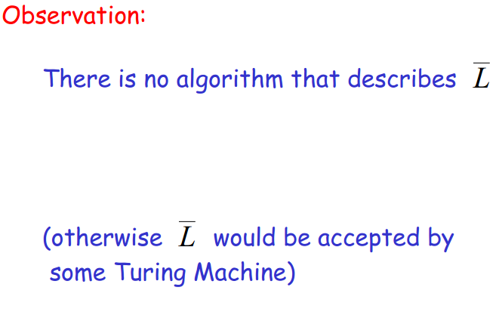

Slide 41
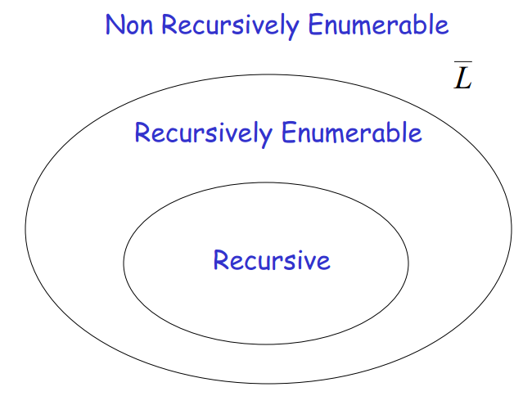

Slide 42
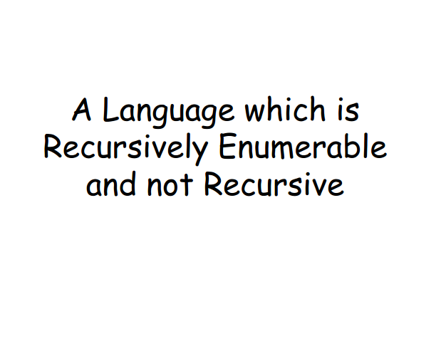

Slide 43
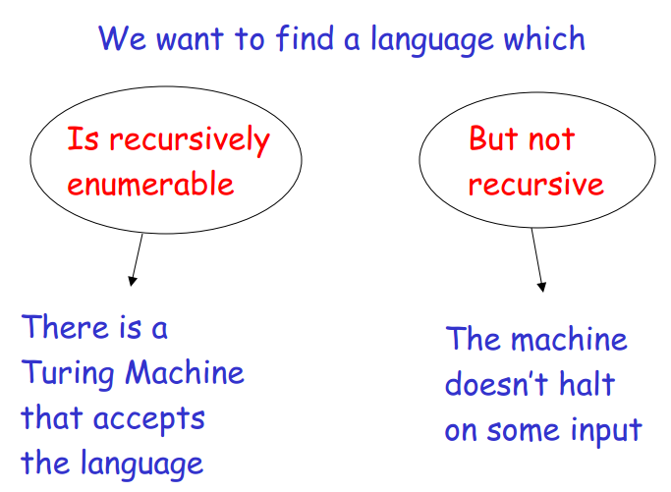

Slide 44
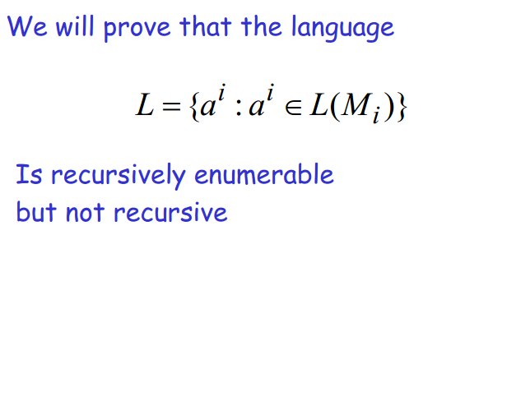

Slide 45
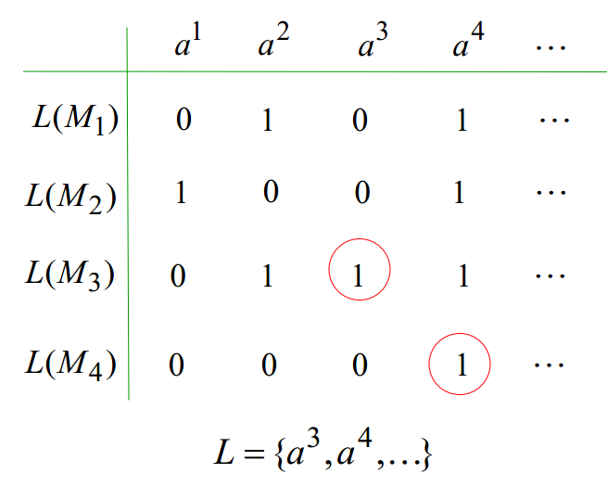

Slide 46
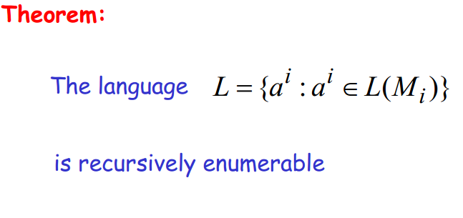
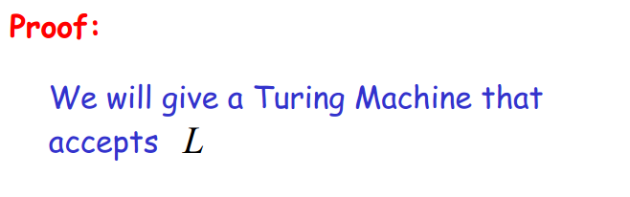

Slide 47
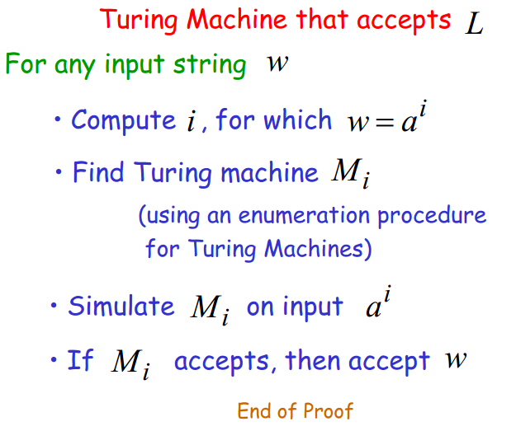

Slide 48
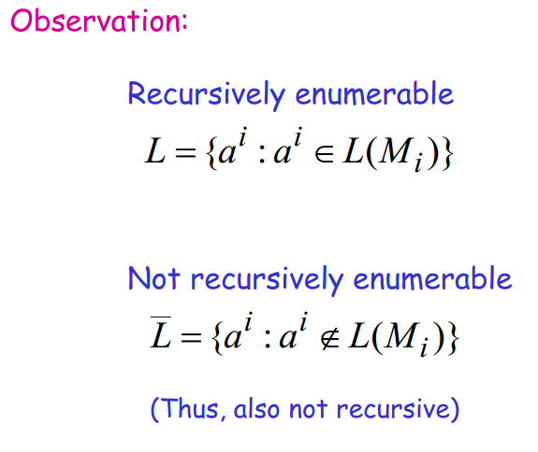

Slide 49
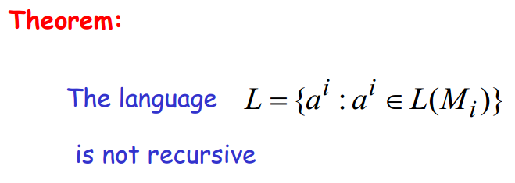

Slide 50
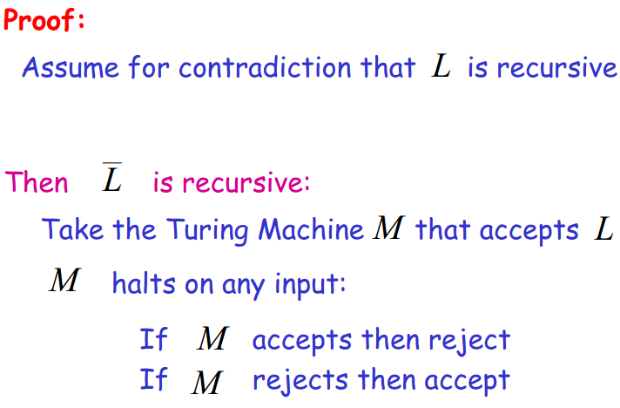

Slide 51
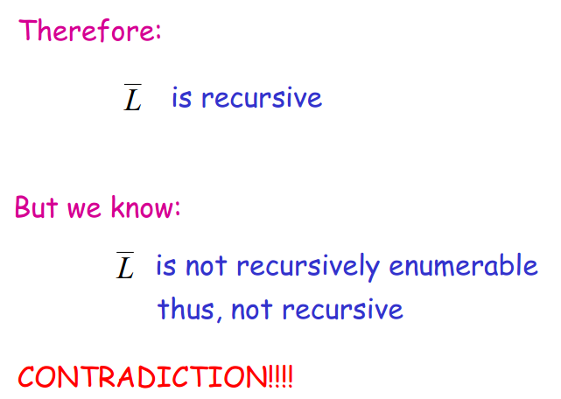

Slide 52
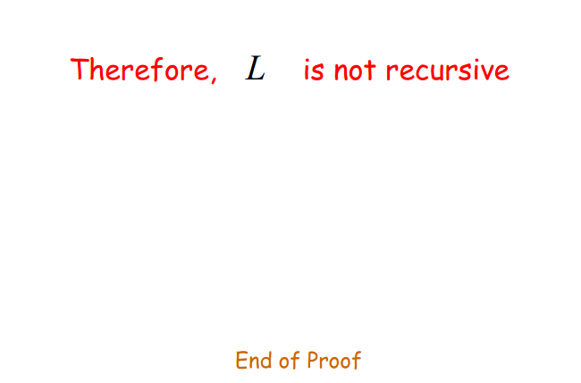

Slide 53
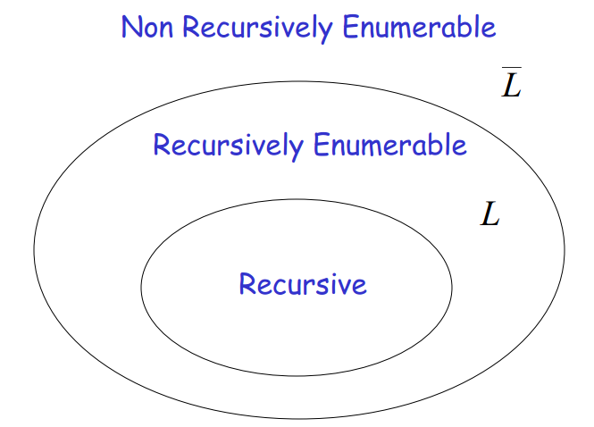

Slide 54


Slide 55


Slide 56


Slide 57


Slide 58


Slide 59


Slide 60


Slide 61


Slide 62


Slide 63


Slide 64


Slide 65


Slide 66


Slide 67


Slide 68


Slide 69


Slide 70


Slide 71


Slide 72


Slide 73


End of Chapter-Six!

